Slide 1
FinanceAdvisor agent
CAPSTONE PROJECT
Presented By: P Anand Kumar
Student name :P Anand Kumar
College Name & Department: KL University, CSIT Department

Slide 2
OUTLINE
Problem Statement
Technology used
Wow factor
End users
Result
Conclusion
Git-hub Link
Future scope
IBM Certifications

Slide 3
Problem Statement
The primary problem statement for the finance industry in 2025 is to navigate an environment of rapid digital transformation, economic volatility, and evolving regulatory frameworks while simultaneously meeting heightened consumer expectations for convenience and security.
This overarching challenge can be broken down into several key problem statements:
1. Balancing Innovation with Regulation and Security
The Problem: Financial institutions must accelerate the adoption of new technologies like AI, machine learning, and embedded finance to remain competitive. However, this rapid innovation creates significant challenges in maintaining robust cybersecurity, protecting customer data, and ensuring compliance with a constantly evolving regulatory landscape (e.g., new rules for AI governance, data privacy, and global frameworks like Basel III). The core problem is how to innovate at speed without compromising security or regulatory integrity.
2. Modernizing Legacy Infrastructure
The Problem: Many traditional financial institutions are hampered by outdated IT infrastructures that are slow, inefficient, and incompatible with modern digital solutions. This "technical debt" makes it difficult to implement new technologies, scale operations, and deliver the seamless, digital-first experiences that consumers now expect from FinTech competitors. The problem is how to undertake a large-scale, costly, and complex modernization without disrupting core operations.

Slide 4
Problem Statement
3. Addressing Economic Uncertainty and Changing Market Dynamics
The Problem: Despite some positive forecasts for growth in certain regions, the global economic outlook remains defined by uncertainty. Financial institutions must prepare for potential challenges such as modest growth, fluctuating interest rates, and geopolitical shocks that can impact lending, credit quality, and investment strategies. For consumers, this uncertainty can lead to financial pressures and weakening personal balance sheets, making it a critical problem for institutions to manage credit risk.
4. Meeting Evolving Consumer Expectations
The Problem: Consumers in 2025 expect hyper-personalized, frictionless, and transparent financial experiences. They are increasingly comfortable with digital-only banking and embedded finance solutions. The problem for institutions is how to deliver these superior customer experiences across all channels while maintaining the highest levels of security and building trust, especially as sophisticated AI-driven fraud and social engineering scams become more prevalent.
5. Bridging the Talent and Skills Gap
The Problem: The push for AI and digital transformation has created a critical need for skilled professionals in areas like data science, AI development, and cybersecurity. There is a fierce competition for this talent, and many smaller or traditional firms struggle to attract and retain the experts needed to drive their technological initiatives. The problem is how to build and nurture a workforce that can both innovate and manage the complexities of a technology-first financial landscape.

Slide 5
Technology used
IBM cloud lite services
Natural Language Processing (NLP)
Retrieval Augmented Generation (RAG)
IBM Granite model

Slide 6
IBM cloud services used
IBM Cloud Watsonx AI Studio
IBM Cloud Watsonx AI runtime
IBM Cloud Agent Lab
IBM Granite foundation model

Slide 7
Wow factors
This agent will significantly reduce research time, improve the quality of literature reviews, help early-stage researchers find direction, and foster interdisciplinary collaboration by making knowledge more accessible and actionable.
Unique features:
Semantic search across research papers, journals, and datasets
Auto-summarization of selected papers
Citation and reference analysis to trace influence
Recommendation of research papers based on a user’s current topic
Trend analysis over time for specific keywords or domains.
Collaboration mapping: suggests potential co-authors or institutions based on similar research interests.

Slide 8
End users
Academic Researchers
Research Institutions and Universities
Industry R&D Teams
Educators

Slide 9
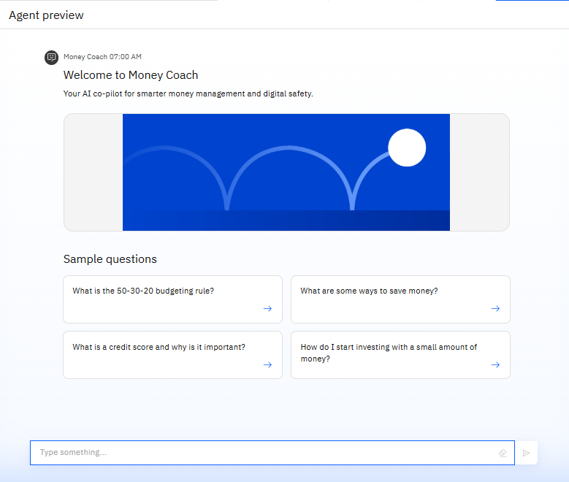
Results

Slide 10
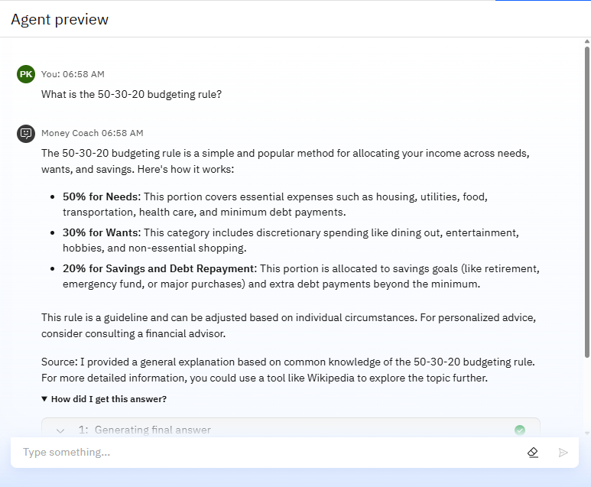
Results

Slide 11
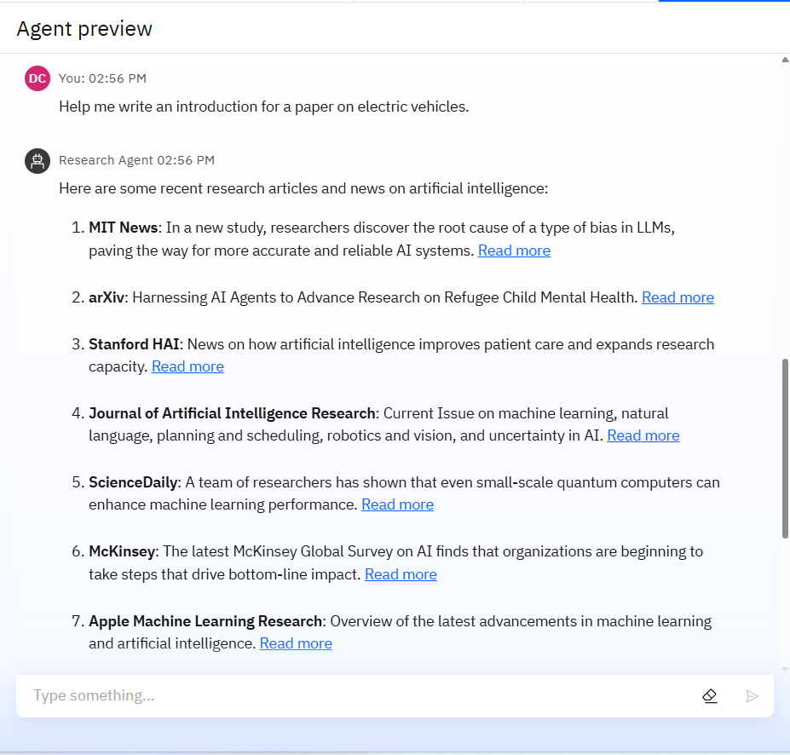
Results

Slide 12
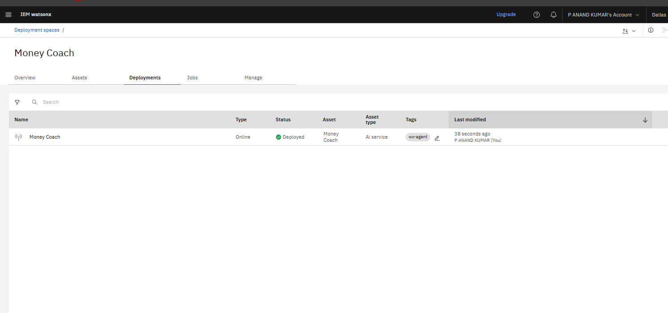
Results
Deployed AI Agent

Slide 13
Conclusion
The agent can generate reports, suggest hypotheses, and even draft sections of research papers.
It saves time by automating repetitive tasks like citation management and data extraction.
Research Agents enhance efficiency, accuracy, and innovation in both academic and industrial R&D.

Slide 14
Future scope
Multilingual Research Support
Voice-Activated Research Assistant
Real-Time Collaboration Features
Research Gap and Novel Topic Identification
Integration with Publishing Platforms
AI-Assisted Paper Drafting

Slide 15
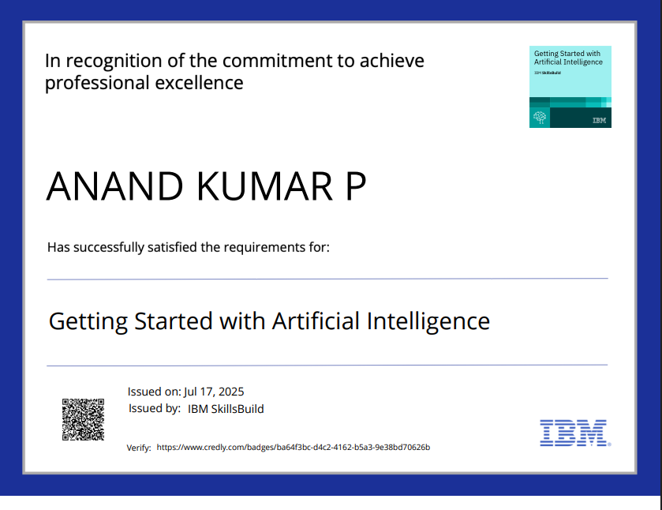
IBM Certifications

Slide 16
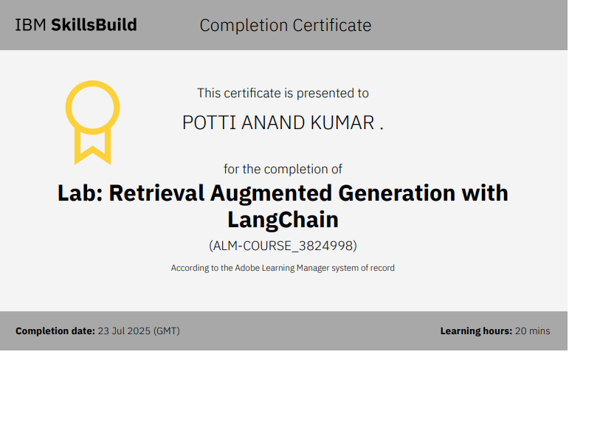

Slide 17
Git hub lik : https://github.com/anandkumarp012/IBM_Money_Coach-Agent

Slide 18
GitHub Link
Make sure that there should be readme file

Slide 19
THANK YOU

